Slide 1

Image Dehazing Using Deep Learning Presentation by
Abu Bakr Siddiq & Razeem Akhtar
(Reg. No. 170929098 & 170929194)
Under the guidance of
Project Supervisor: Dr. Kshetrimayum Lochan Assistant Professor, Dept. of Mechatronics Engineering Manipal Institute of Technology | Project Co-Supervisor: Dr. Munendra Singh Assistant Professor, Dept. of Mechatronics Engineering Manipal Institute of Technology
DEPARTMENT OF MECHATRONICS
August, 2021

Slide 2
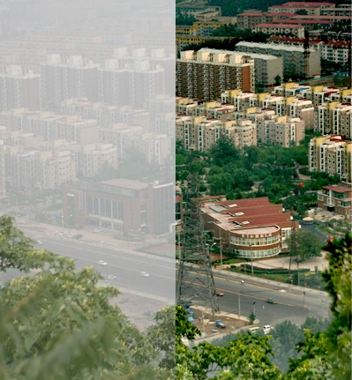
OVERVIEW
Review of state of the art dehazing models.
Comparative study on RESIDE dataset.
Hazy-KITTI dataset synthesis.
Training strategy to combat the resource constraint.
Development of a new model for dehazing.
Comparative Study on Hazy-KITTI.
Future scope.
Credits: Bermen et. al [26]
Hazy vs. Clear image

Slide 3
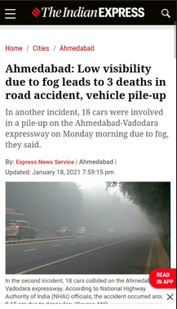
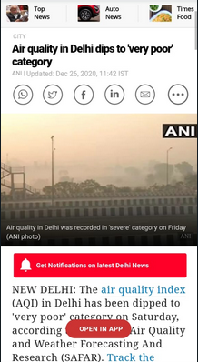
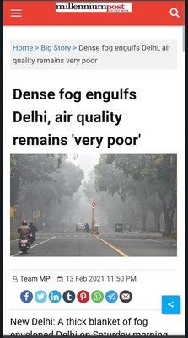
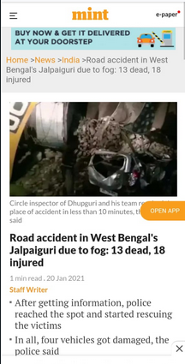
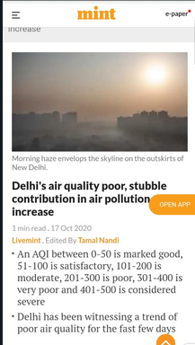
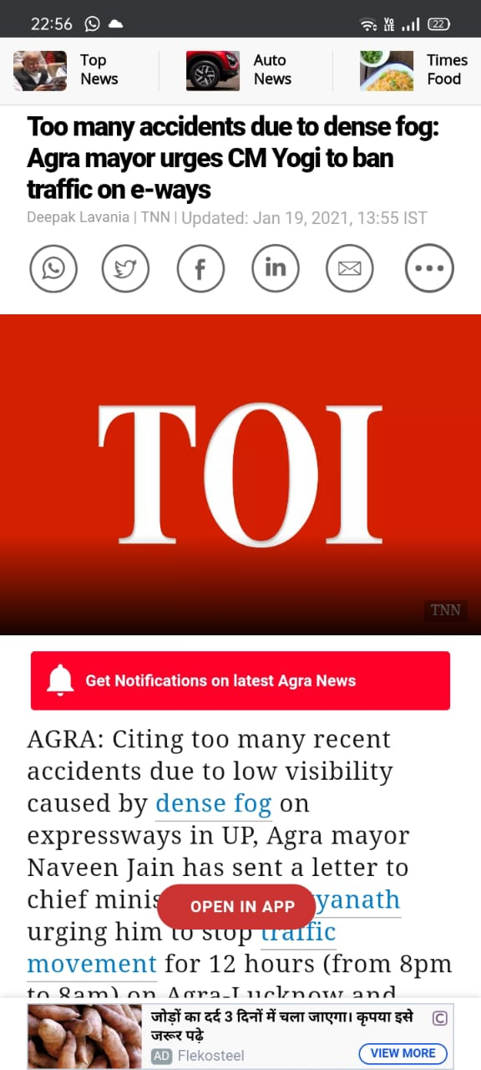
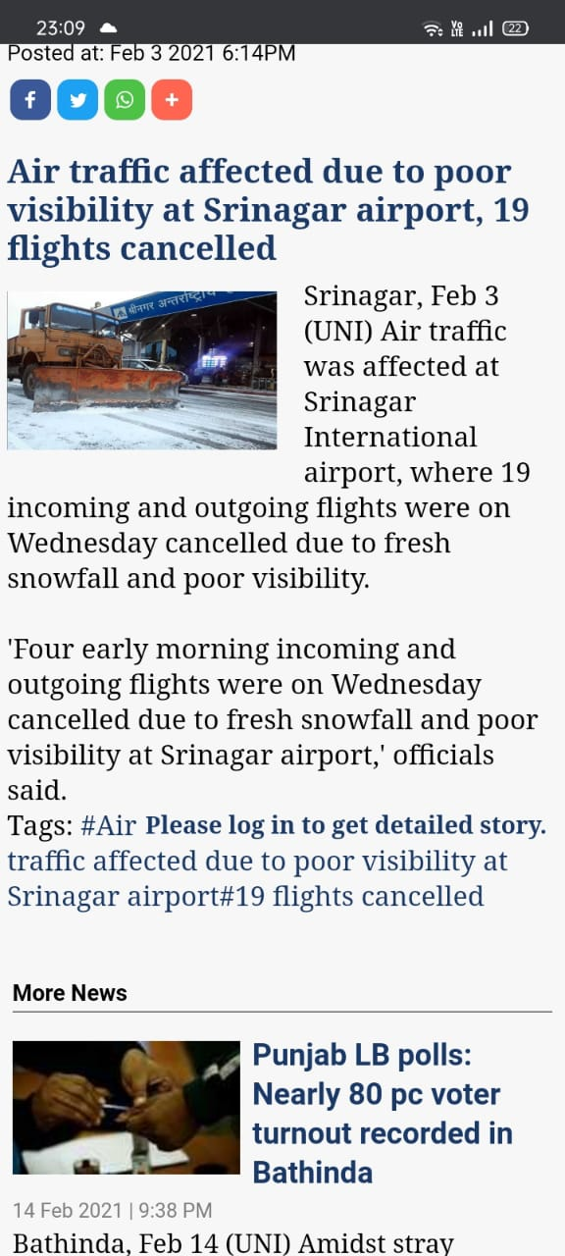
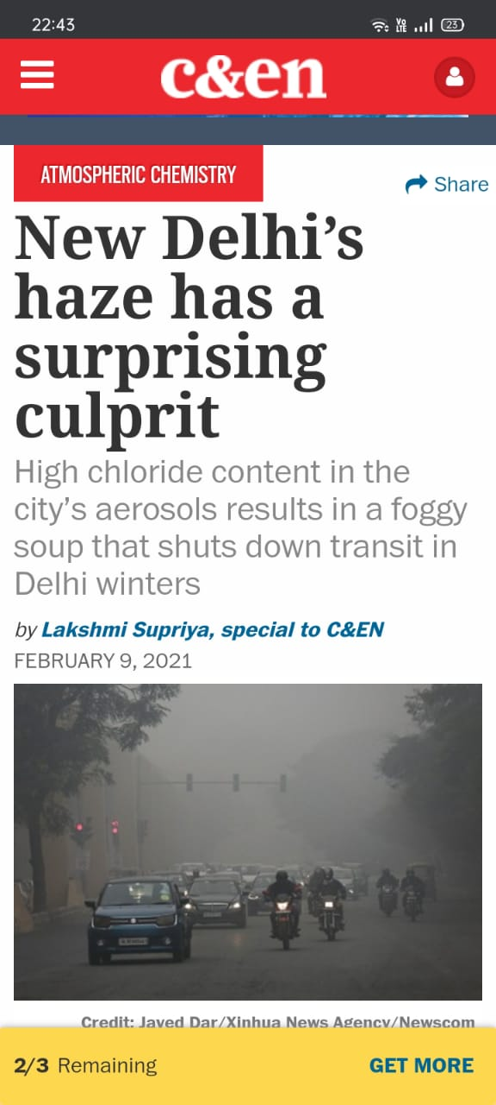
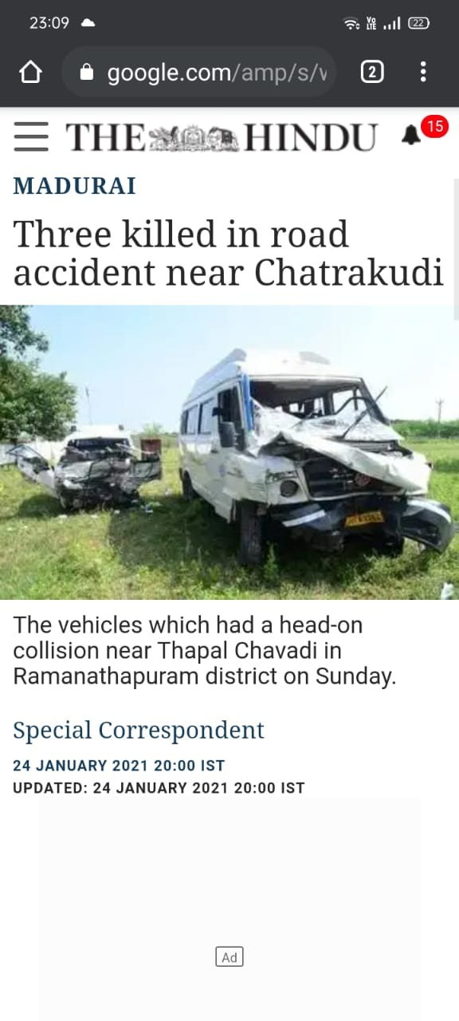
MOTIVATION

Slide 4
OBJECTIVES
• Study various state of the art dehazing algorithms and compare them using common performance metrics.
• To analyse the performance of state of the art models on No Reference and haze specific metrics.
• Develop a dehazing model that readily integrates with the software stack for autonomous
cars.
• Develop a model that has sound theoretical backing, so that not only dehazed image but
other haze related components can be extracted.
• Create a dataset which is driven towards dehazing images of roads.
• Perform a comparative study where novel model is compared to other state of the art models and bring out the novelty of the new model.

Slide 5
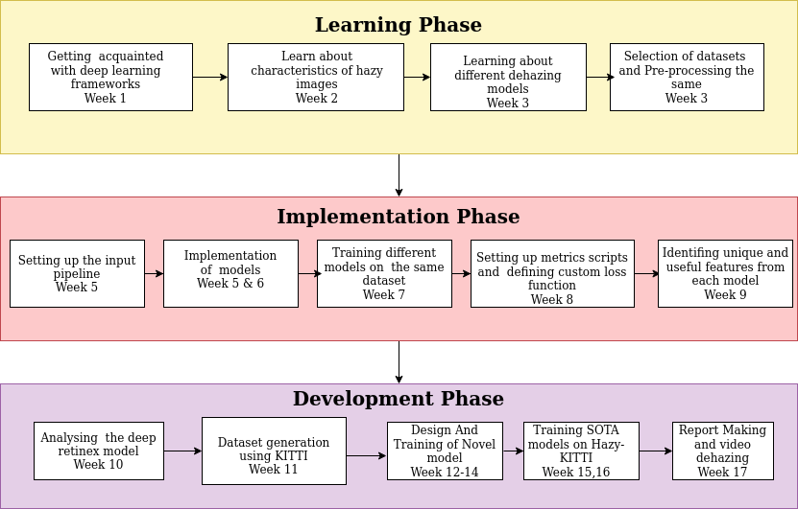
PROJECT FLOW

Slide 6
Overview of the networks considered
DCP
Dehazenet
LCA
U-net
GMAN
GCA
FFA

Slide 7
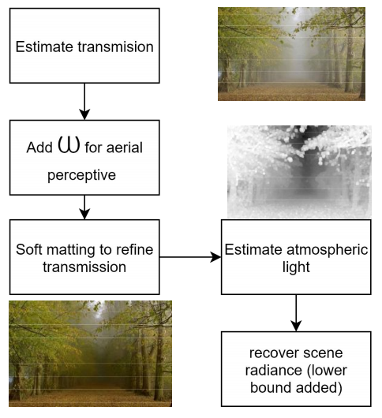
Dark Channel prior
DCP is a kind of statistic for haze free images, based on assumption that local patches in haze free images contain some pixels which have very low intensities in at least one color channel.
Uses the atmosphere scattering model as a starting point as base.
DCP is based on digital imaging principle so it is simple and low cost approach.
Has shortcomings such as colour distortion, detail loss and computational complexity

Slide 8
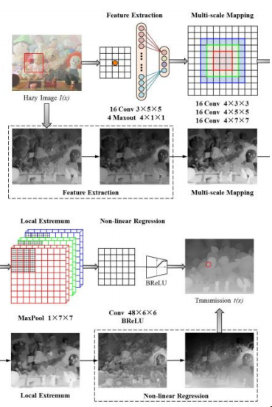
Dehaze Net
DehazeNet adopts Convolutional Neural Networks (CNN) based deep architecture, whose layers are specially designed to embody the established assumptions/priors in image dehazing.
Layers of Maxout units are used for feature extraction, which can generate almost all haze-relevant features.
Uses a novel nonlinear activation function in DehazeNet, called Bilateral Rectified Linear Unit (BReLU), which is able to improve the quality of recovered haze-free image
Drawback - dehazing sky region and the scene objects which are inherently similar to the atmospheric light (such as the fair-skinned complexion)
Dehazenet Architecture [8]

Slide 9
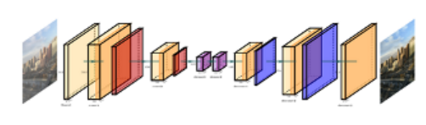
Light Convolution Autoencoder
LCA net Architecture [7]
Light convolutional Autoencoder (LCA) net is a light network which focuses on being faster rather than performance.
The model has around 53 thousand trainable parameters.
The model is a sequential one with first part of the model acting like an encoder i.e. the image is reduced to a feature vector and then a decoder network is used to recover the haze free image from the feature vector
The drawback was the dehazed image had a small amount of haze and the image also showed blurring effect.

Slide 10
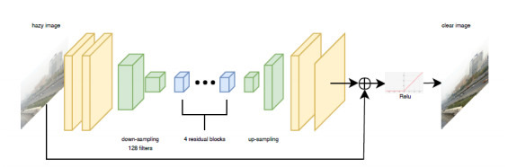
Generic Model-Agnostic Convolutional Network (GMAN)
GMAN net Architecture [9]
It does not estimate any atmospheric scattering model and only depends on trainable parameters and hence it learns complex hazy features and structures
The paper boasts a generative network that uses encoder-decoder structure with down and up-sampling factor of 2.
As it is a new type of network there is not any concrete papers and research on this network.

Slide 11
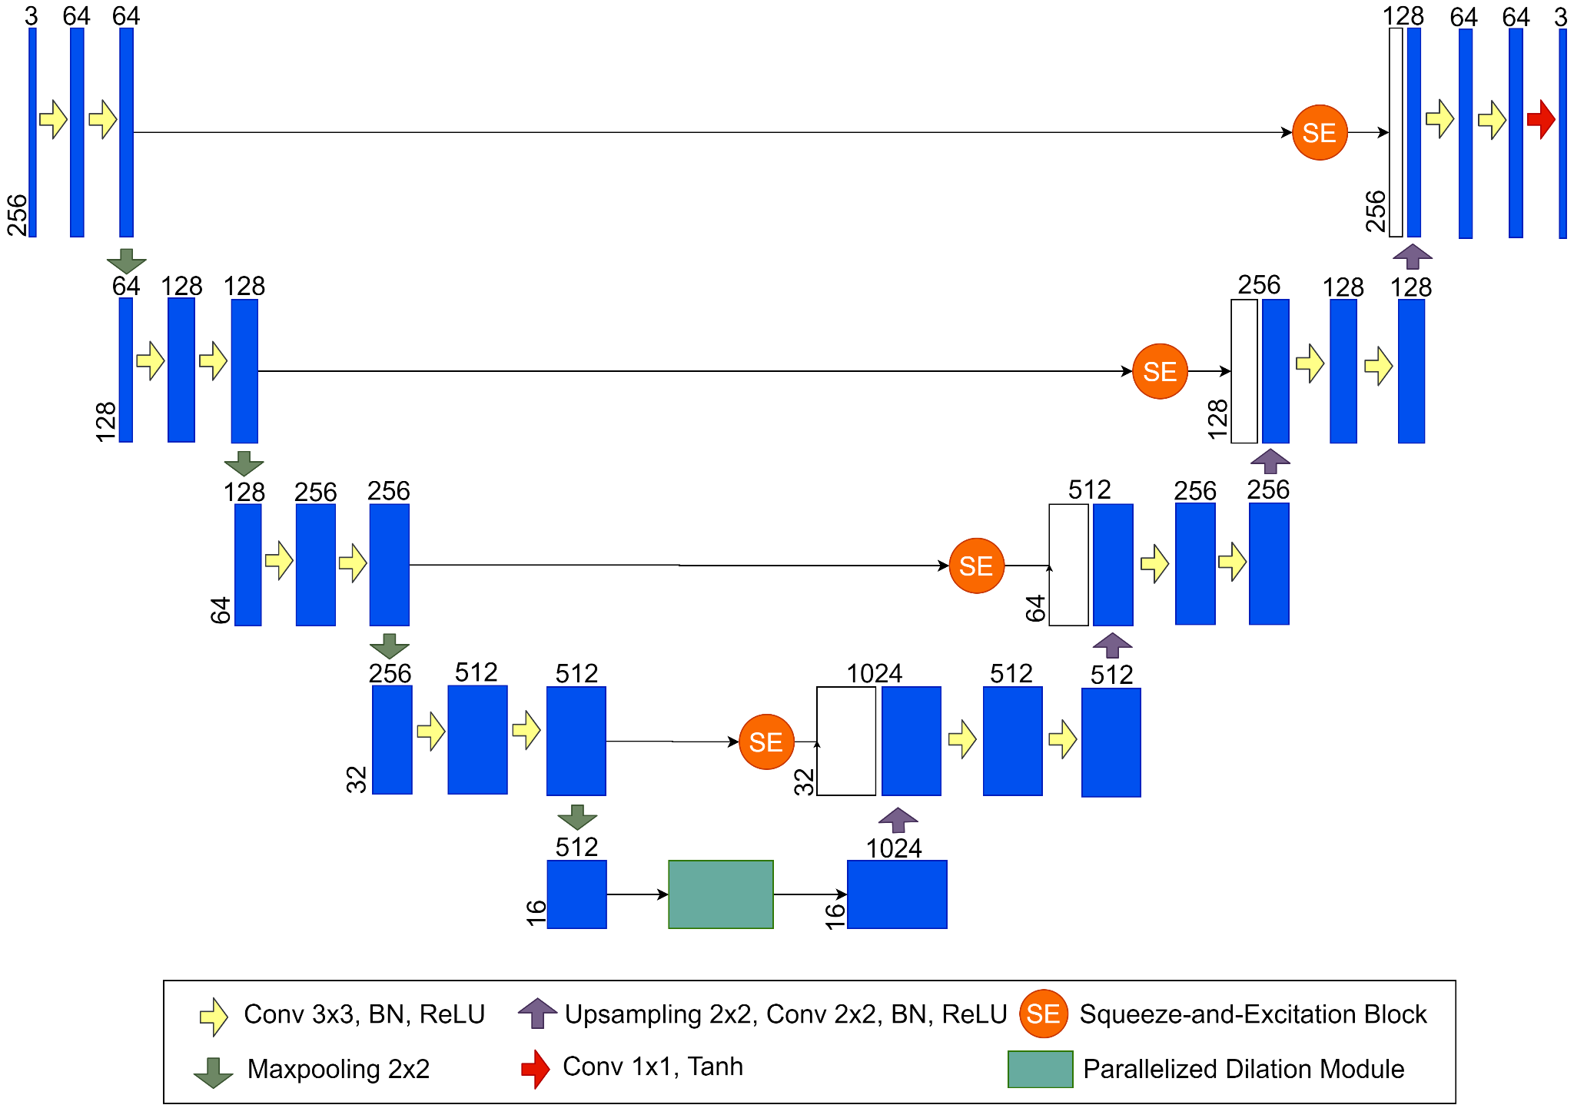
U-Net
An autoencoder architecture.
Squeeze blocks consists of conv. and pool layers.
Squeeze blocks after activation (excitation) mapped to the layers of decoder arm.
Has parallel dilation blocks in bottle neck part of the network.
Very heavy network with around 2 million parameters.
The generated dehazed image has lot of noise present, but the haze density is reduced.
U-net Architecture [11]

Slide 12
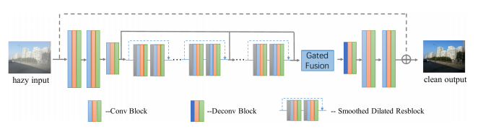
Gated Context Aggregation Network
GCA net Architecture [10]
Using the modern smoothed dilation technique with dilated convolution in the network which increases field of kernel and also uses a gated sub-network which blends features from multiple scales of the same image.
The network is currently ranked second best on basis of PSNR on RESIDE dataset.
The model is quite computationally heavy and we were unable to increases batch size from four when training on colab (GPU). It is also a very complex net with around 500k trainable parameters.
We also observed that when objects are too near the model forms black regions .

Slide 13
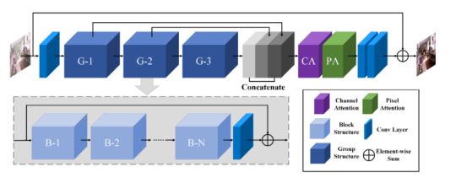
Feature Fusion Attention network (FFA)
FFA net Architecture [13]
Current best ranked model for single image dehazing. Proposes Feature Attention (FA) module combines Channel Attention with Pixel Attention mechanism.
Uses concept of groups i.e. similar small models for a block and many such blocks for a group. The work proposes 3 groups of 19 blocks each.
FFA network has a powerful advantage in the restoration of image detail and color fidelity.
The network is very heavy and we had to downsize it so we used 3 groups which consists of 14 blocks each and while training this model also batch size couldn’t be increases from 1.

Slide 14
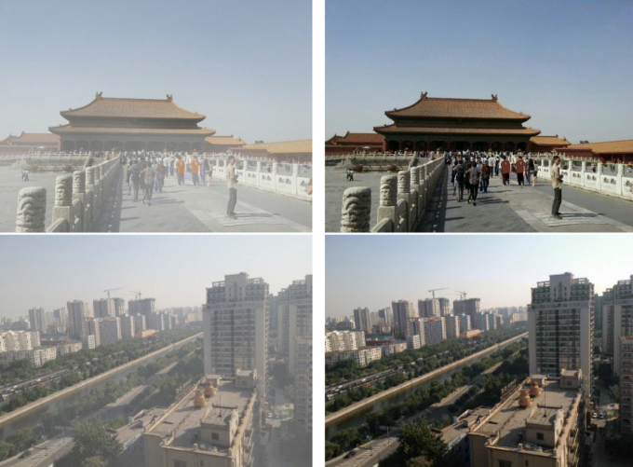
RESIDE dataset
REalistic Single Image DEhazing
Aimed at evaluating performance of single image Dehazing algorithms.
The RESIDE:V0 provides about 313,000 synthetic outdoor hazy images
Presents innovative set of evaluation techniques besides PSNR and SSIM, also employs no reference metrics such as BLIINDS-II and human subjective score for comparison (clearness & authenticity) fitted on Bradley-terry model.
Provides a benchmark for single image dehazing
Presents comparison and limitations of many state of the art, such as DehazeNet, AOD-Net, DCP etc
Haze vs Ground Truth [5]
Notes:
Add pic

Slide 15
Comparative study on RESIDE
Metrics | LCA | DHZ | DEHZ+ATTN | DCP | GMAN | GCA | FFA | U-NET
PSNR | 17.07 | 17.23 | 17.00 | 12.00 | 14.8 | 20.13 | 20.67 | 19.38
SSIM | 0.65 | 0.66 | 0.67 | 0.61 | 0.64 | 0.77 | 0.79 | 0.73
FADE | 0.95 | 0.5 | 0.87 | 0.39 | 0.65 | 0.91 | 1.24 | 0.68
NQIE | 4.42 | 2.93 | 3.12 | 2.85 | 2.70 | 2.70 | 2.67 | 3.71
CEIQ | 3.27 | 3.33 | 3.25 | 3.19 | 3.22 | 3.22 | 3.42 | 3.4

Slide 16
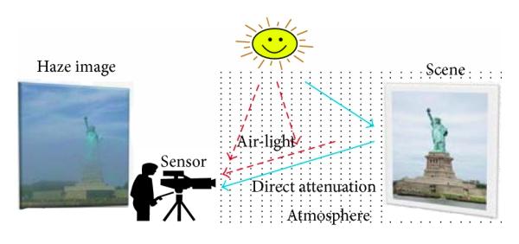
Atmospheric Scattering Model
The haze present in a image is due to two features:
1. Direct Attenuation: results from decay in the medium
2. Air light: occurs due to the scattering of light in the surrounds
I(x) = J(x)t(x) + A(1−t(x))
Where I is the observed intensity, J is the scene radiance, A is the global atmospheric light, and t is the medium transmission describing the portion of the light that is not scattered and reaches the camera.
t(x) = e^{-β.d(x)}
Where β is the scattering coefﬁcient of the atmosphere and d(x) is distance from the scene point It indicates that the scene radiance is attenuated exponentially with the scene depth. The model assumes homogeneous scattering of light and a constant scattering coefﬁcient.
Credits: Lie quan
Atmosphere scattering model

Slide 17
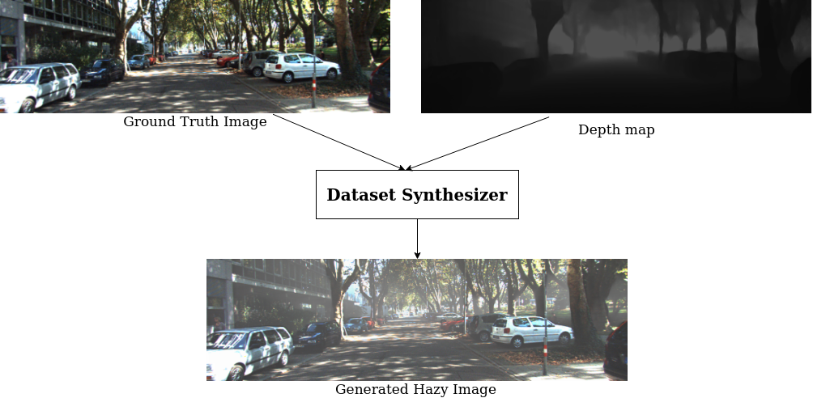
Dataset Haze-KITTI synthesis

Slide 18
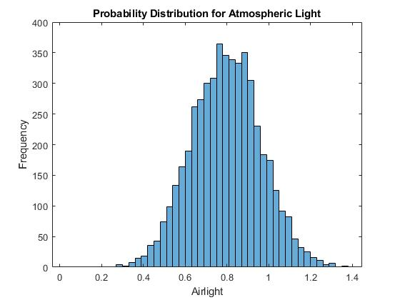
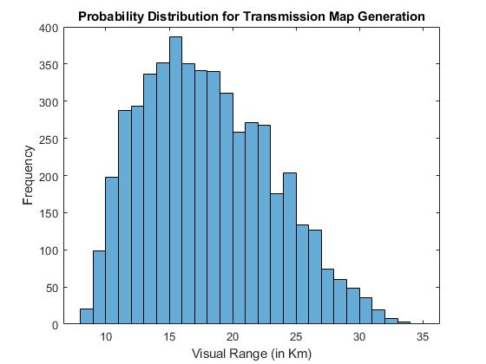
Selection of Values for dataset synthesis
I = srgb2lrgb(I0);
transmission = exp(bsxfun(@times,-beta,d));
Ic = bsxfun(@times,transmission,I)+bsxfun(@times,1-transmission,A);
I2 = lrgb2srgb(Ic);

Slide 19
Design of Novel Network

Slide 20
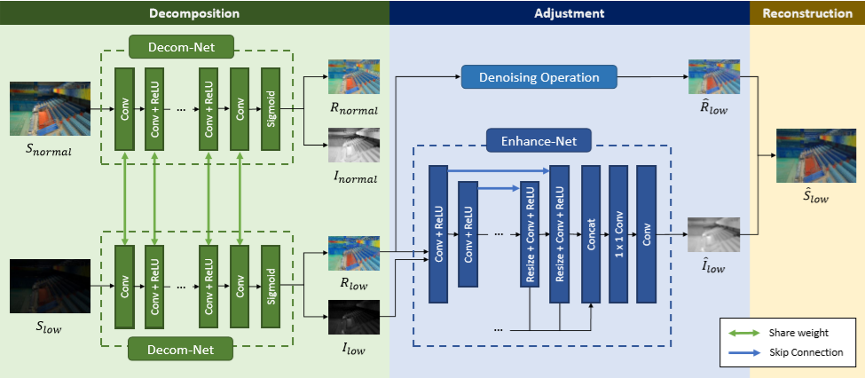
Base model
Looked into various domains and singled out Deep retinex decomposition model as a very suitable one for building novel dehazing network.
The model was chosen as it is currently one of the best for low light enhancement and the field is very similar to image dehazing as both deal with loss of contrast.
The model further has sub blocks which can be replaced with dehazing specific blocks
Deep retinex Decomposition [14]

Slide 21

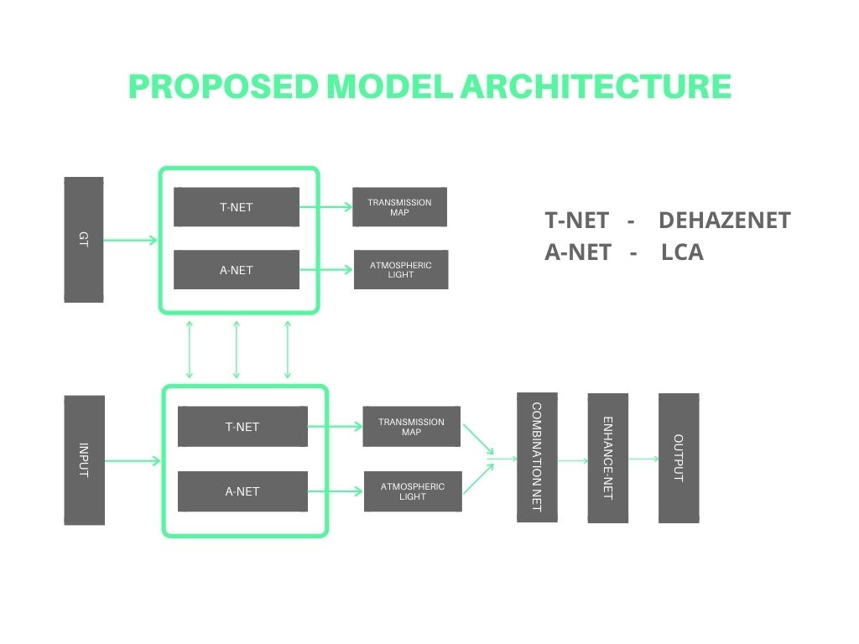

Initial Proposed Model
Decom-net

Slide 22
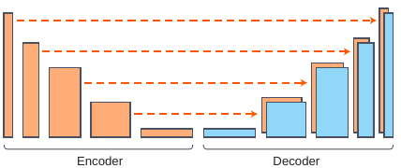
T-net
Transmission map is directly proportional to the depth map.
The first attempt to generate a transmission map was taken up in dehazenet.
Reviewed different monocular depth prediction models, like monodepth, monodepth2, densedepth and Adabins.
Shortlisted densedepth based on its modularity, simplicity and ability to be extended to dehazing domain.
Depthdense is a autoencoder architecture, where encoder is a densenet, and decoder is made of upsampling blocks.
Densedepth net Architecture [21]

Slide 23
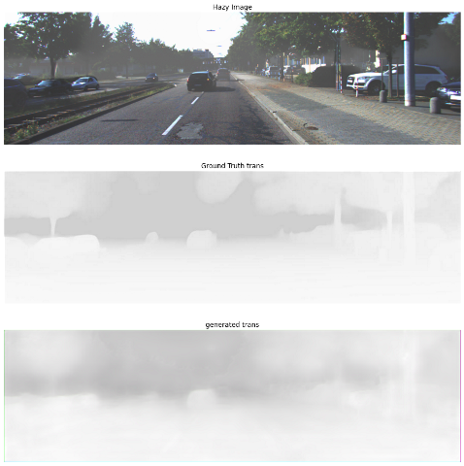
T-net
The outputs of T_net are scaled to values between 0-1 as they reflect a fraction.
T_net based on a densedepth model with upsampling, bounded ReLU added.
T_net was trained with starting weights from KITTI depth prediction dataset.
The model was trained on transmission maps from Hazy-KITTI for 40 epochs and MSE of 0.0017 was achieved.
T_net Output

Slide 24
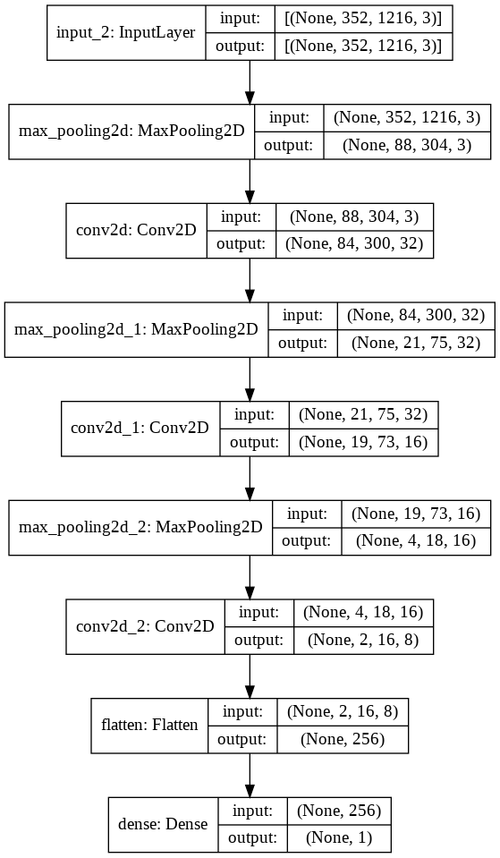
A-net
Inspiration taken from LCA and Dark channel prior.
Made use of layers such as max pool, because of properties of atmospheric light.
Dilation concept used so that even small kernels can capture bigger region of pixels.
Ran for 20 epochs on Hazy-KITTI dataset and obtained a Mean square error of 0.0191.

Slide 25
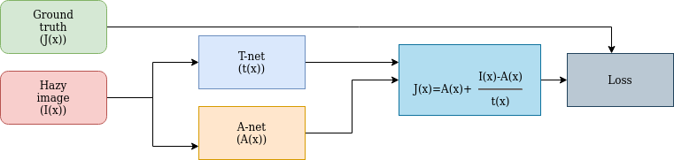
ODD network Architecture

Slide 26
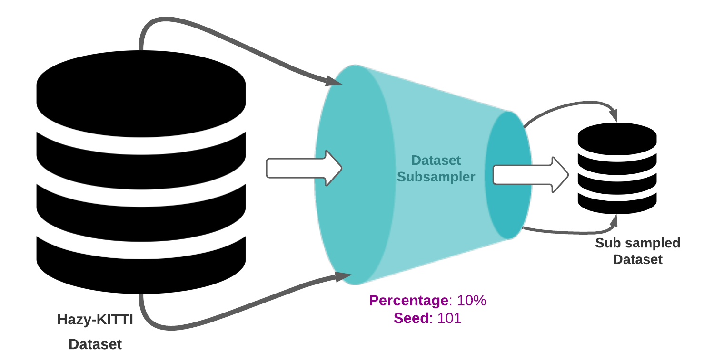
Data Processing

Slide 27
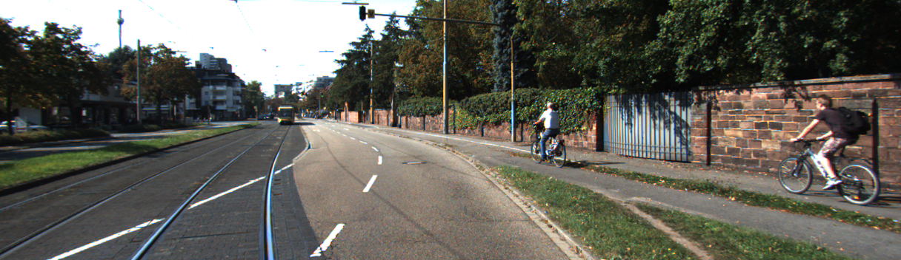
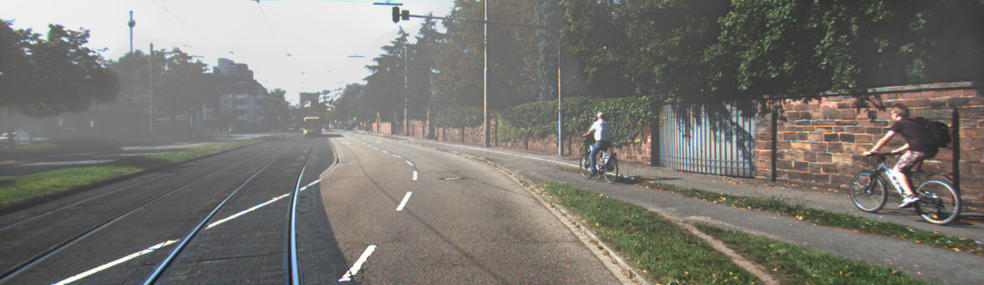
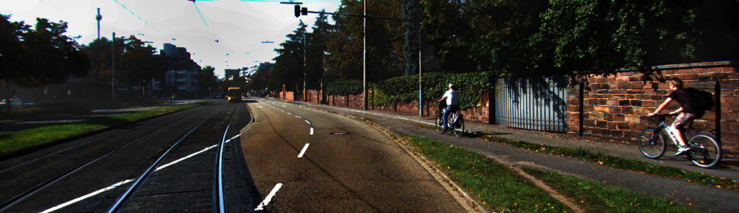
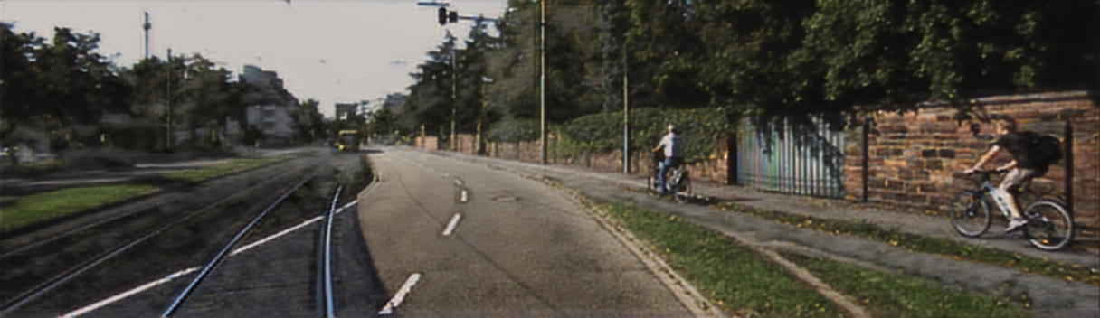
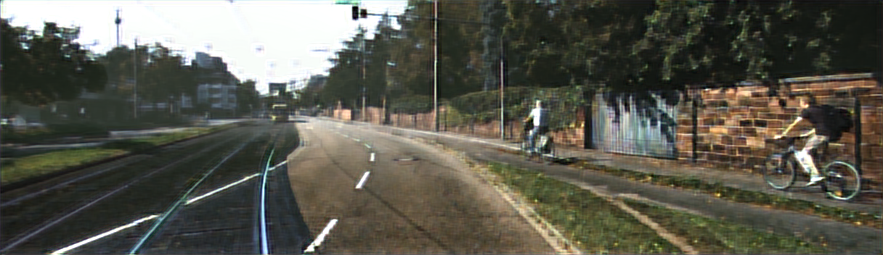
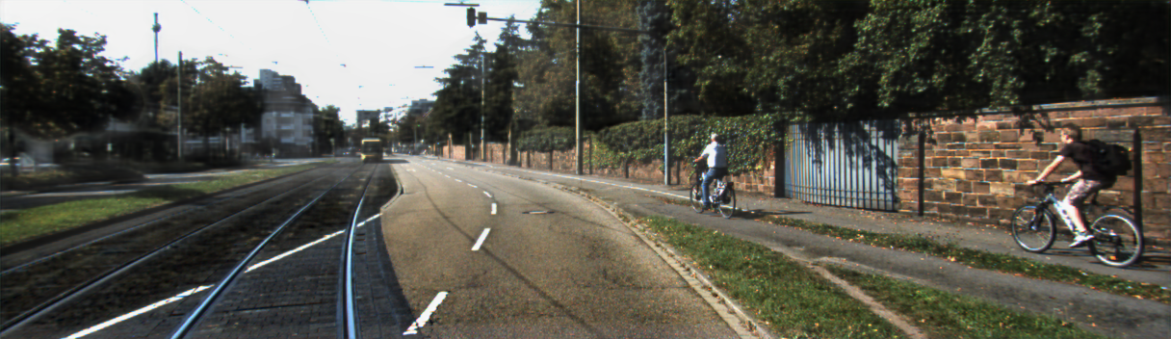
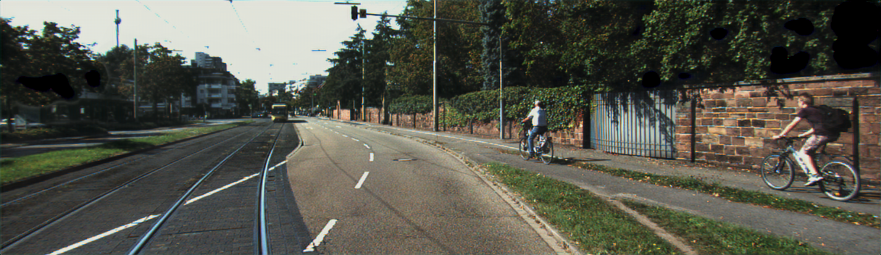
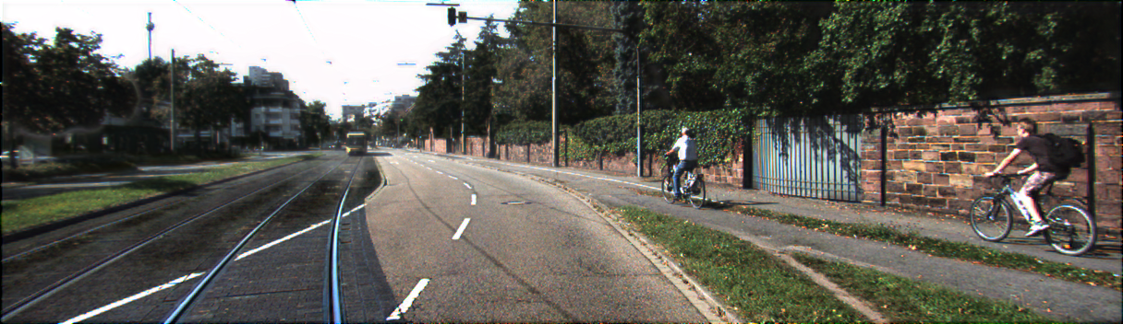
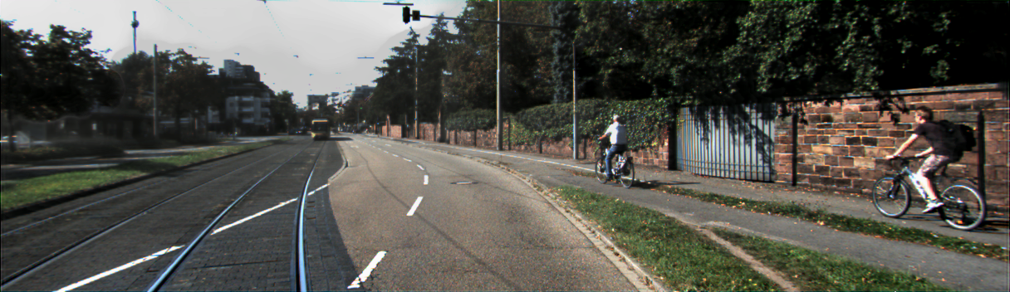
Ground Truth
Hazy Image
Dark Channel Prior
LCA
Dehazenet
GMAN
GCA
FFA
OURS

Slide 28
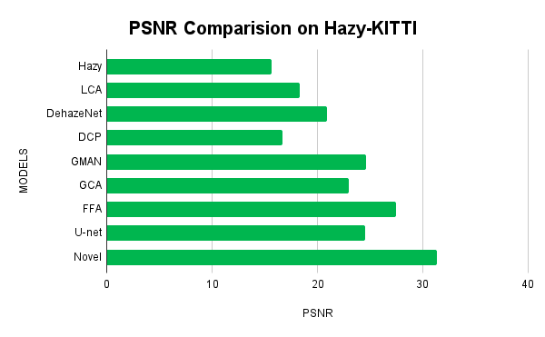
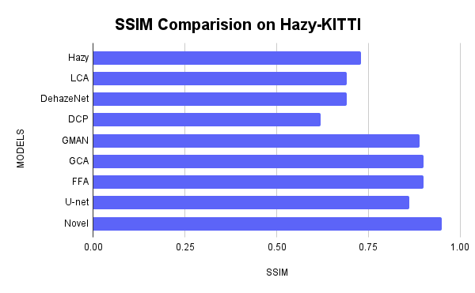
Comparison of models

Slide 29
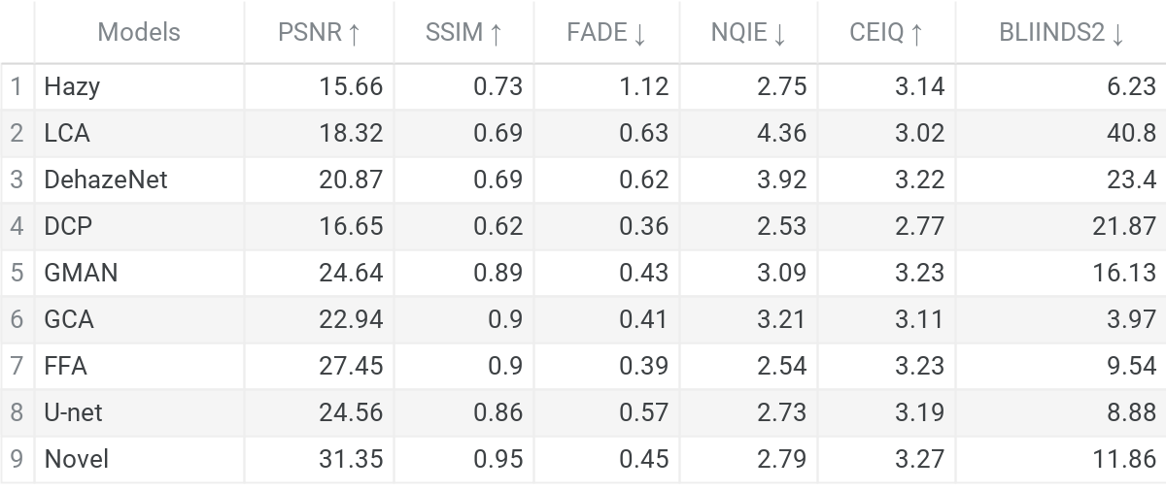
Results
https://paperswithcode.com/sota/image-dehazing-on-kitti

Slide 30
Future scope
Develop better impainting algorithms.
Improve atmospheric scattering model.
Depth correction models need to be developed.
Advancement in the field of No reference metrics.
Image dehazing architectures and models which are application driven.
Integrate the state of the art models in software stack of autonomous cars and perform rigorous testing .
Development of a denoising and enhance net to give better outputs.

Slide 31
Contributions of the project
One of the first works to do a rigorous comparison in the field of dehazing, With not only conventional metrics like PSNR, but also considering no reference metrics like naturalness and haze specific metrics like FADE.
Secondly as shown before we have developed a new dataset named Hazy-KITTI, based on KITTI dataset and LiDAR maps.
Designed ODD net which is a new model for dehazing based on basic principles of dehazing.
Performed a comparative study of state of the art models on Hazy-KITTI.

Slide 32
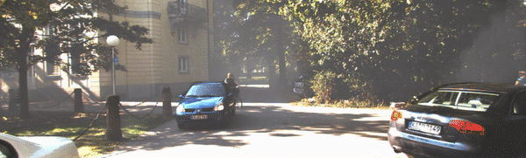
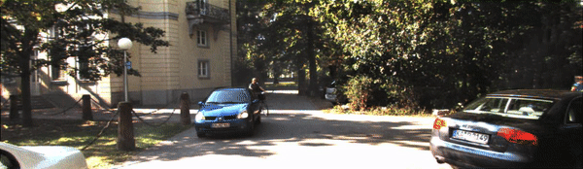
Final Results

Slide 33

THANK YOU
For further information

Slide 34
References
[1] K. He, J. Sun and X. Tang, ”Single Image Haze Removal Using Dark Channel Prior,” in IEEE Transactions on Pattern Analysis and Machine Intelligence, vol. 33, no. 12, pp. 2341-2353, Dec. 2011, doi: 10.1109/TPAMI.2010.168.
[2] K. He, J. Sun, and X. Tang. Guided image filtering. In ECCV, pages 1–14. 2010.
[3] Q. Zhu, J. Mai and L. Shao, ”A Fast Single Image Haze Removal Algorithm Using Color Attenuation Prior,” in IEEE Transactions on Image Processing, vol. 24, no. 11, pp. 3522-3533, Nov. 2015, doi: 10.1109/TIP.2015.2446191.
[4] K. Tang, J. Yang and J. Wang, ”Investigating Haze-Relevant Features in a Learning Framework for Image Dehazing,” 2014 IEEE Conference on Computer Vision and Pattern Recognition, Columbus, OH, USA, 2014, pp. 2995-3002, doi: 10.1109/CVPR.2014.383.
[5] B. Li et al., ”Benchmarking Single-Image Dehazing and Beyond,” in IEEE Transactions on Image Processing, vol. 28, no. 1, pp. 492-505, Jan. 2019, doi: 10.1109/TIP.2018.2867951.
[6] C. O. Ancuti, C. Ancuti, R. Timofte and C. De Vleeschouwer, ”O-HAZE: A Dehazing Benchmark with Real Hazy and Haze-Free Outdoor Images,” 2018 IEEE/CVF Conference
on Computer Vision and Pattern Recognition Workshops (CVPRW), Salt Lake City, UT,USA, 2018, pp. 867-8678, doi: 10.1109/CVPRW.2018.00119.
[7] A. Pavan Bennur, Adithya Gaggar, Mohit S S, Shylaja. (2020). LCA-Net: Light Convolutional Autoencoder for Image Dehazing.

Slide 35
[8] B. Cai, X. Xu, K. Jia, C. Qing and D. Tao, ”DehazeNet: An End-to-End System for Single Image Haze Removal,” in IEEE Transactions on Image Processing, vol. 25, no. 11, pp.
5187-5198, Nov. 2016, doi: 10.1109/TIP.2016.2598681.
[9] Z. Liu, B. Xiao, M. Alrabeiah, K. Wang and J. Chen, ”Single Image Dehazing with a Generic Model-Agnostic Convolutional Neural Network,” in IEEE Signal Processing Letters, vol. 26, no. 6, pp. 833-837, June 2019, doi: 10.1109/LSP.2019.2910403.
[10] Chen, D, He, M, Fan, Q, Liao, J, Zhang, L, Hou, D, Yuan, L Hua, G 2019, Gated context aggregation network for image dehazing and deraining. in Proceedings - 2019 IEEE Winter
Conference on Applications of Computer Vision, WACV 2019., 8658661, Proceedings IEEE Winter Conference on Applications of Computer Vision, WACV , IEEE, pp. 1375-
1383, 19th IEEE Winter Conference on Applications of Computer Vision (WACV 2019),
Waikoloa Village, United States, 7/01/19.
[11] Y. -W. Lee, L. -K. Wong and J. See, ”Image Dehazing With Contextualized Attentive U-NET,” 2020 IEEE International Conference on Image Processing (ICIP), Abu Dhabi, United
Arab Emirates, 2020, pp. 1068-1072, doi: 10.1109/ICIP40778.2020.9190725.
[12] Ayush Singh, Ajay Bhave, Dilip K. Prasad, “Single image dehazing for a variety of haze scenarios using back projected pyramid network,” arXiv:2008.06713 [eess.IV]
[13] Qin, Xu & Wang, Zhilin & Bai, Yuanchao & Xie, Xiaodong & Jia, Huizhu. (2019). FFA-Net: Feature Fusion Attention Network for Single Image Dehazing.
[14] Wang, Wenjing & Yang, Wenhan & Liu, Jiaying. (2018). Deep Retinex Decomposition for Low-Light Enhancement.
[15] H. Zhao, O. Gallo, I. Frosio and J. Kautz, ”Loss Functions for Image Restoration With Neural Networks,” in IEEE Transactions on Computational Imaging, vol. 3, no. 1, pp. 47-57,
March 2017, doi: 10.1109/TCI.2016.2644865.

Slide 36
[16] Mittal, Anish Moorthy, Anush & Bovik, Alan & Chen, Chang-Wen & Chatzimisios, Periklis & Dagiuklas, Tasos & Atzori, Luigi. (2015). No-Reference Approaches to Image and Video Quality Assessment. 10.1002/9781118736135.ch5.
[17] L. K. Choi, J. You and A. C. Bovik, ”Referenceless Prediction of Perceptual Fog Density and Perceptual Image Defogging,” in IEEE Transactions on Image Processing, vol. 24, no. 11, pp. 3888-3901, Nov. 2015, doi: 10.1109/TIP.2015.2456502.47
[18] Y. Liu and X. Li, ”No-Reference Quality Assessment for Contrast-Distorted Images,” in IEEE Access, vol. 8, pp. 84105-84115, 2020, doi: 10.1109/ACCESS.2020.2991842.
[19] Y. Zhang, L. Ding and G. Sharma, ”HazeRD: An outdoor scene dataset and benchmark for single image dehazing,” 2017 IEEE International Conference on Image Processing (ICIP), 2017, pp. 3205-3209, doi: 10.1109/ICIP.2017.8296874.
[20] Geiger A, Lenz P, Stiller C, Urtasun R. Vision meets robotics: The KITTI dataset. The International Journal of Robotics Research. 2013;32(11):1231-1237. doi:10.1177/0278364913491297
[21] I. Alhashim and P. Wonka, “High quality monocular depth estimation via transfer learning,” 2018, arXiv:1812.11941. [Online]. Available:http://arxiv.org/abs/1812.11941
[22] Clément Godard, Oisin Mac Aodha and Gabriel J. Brostow, ”Digging into self-supervised monocular depth estimation”, CoRR, 2018.
[23] G. Huang, Z. Liu, L. v. d. Maaten and K. Q. Weinberger, ”Densely connected convolutional networks”, Proc. Comput. Vision Pattern Recognit., pp. 2261-2269, 2017.
[24] https://github.com/cxtalk/DehazeZoo
[25] https://github.com/onnx/onnx
[26] D. Berman, T. Treibitz and S. Avidan, "Non-local Image Dehazing," 2016 IEEE Conference on Computer Vision and Pattern Recognition (CVPR), 2016, pp. 1674-1682, doi: 10.1109/CVPR.2016.185.

